Slide 1

Dr Amina Muazzam
Individual Counseling With
The Terminally Ill

Slide 2

Terminal Illness
A disease that cannot be cured and that is reasonably expected to result in the death of the person within a short period of time is termed as terminal illness.

Slide 3
Terminal Illness
Cancer
Kidney Failure
Alzheimer`s Disease
HIV/ AIDS
Dementia
Parkinsn`s Disease

Slide 4

Lifestyle
Lifestyle after diagnosis largely varies depending on management decisions and also the nature of the disease, and there may be living restrictions depending on the condition of the patient. Oftentimes, terminal patients may experience depression or anxiety associated with oncoming death, and family and caregivers may struggle with psychological burdens as well. Psychotherapeutic interventions may help alleviate some of these burdens, and is often incorporated in palliative care

Slide 5
Counseling Terminal Illness
Counselors working with terminally ill individuals work in a multi disciplinary team to provide psychological comfort to the dying and their family. They may normalize emotions during a difficult time, provide spiritual support, educate about normal physical, emotional, and social changes, and assist in managing practical problems.

Slide 6


Slide 7
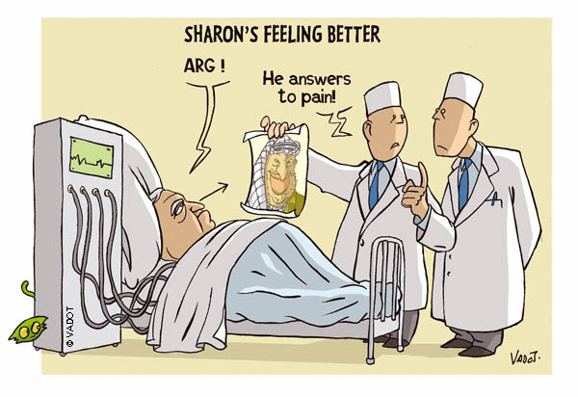

Slide 8
Counselor must be able to
  Understand the illness experience
  Perceive each patient’s experience as unique
  Build a therapeutic alliance
  Develop self-awareness
  Communication skills
  Listening skills
  Non-verbal communication
  Empathy
  Assertiveness

Slide 9
Needs of the Terminally Ill Counseling
Tasks of counselors include helping the dying individual prepare for the reality of death. This is done through education and supportive therapeutic interventions about the dying process that address the physical, emotional, social, spiritual, and practical needs.

Slide 10


Slide 11


Slide 12

Complementary and Alternative Therapies
Therapies such as acupuncture and aromatherapy are often sought to promote relaxation for example – and in an indirect way can help to alleviate the stress of close family. As a result of the client often feeling more positive after treatment, the career or relative feels more optimistic and supported.

Slide 13


Slide 14
Bereavement Counseling
If you’re not ready to discuss your situation with the ones you love, or if you would prefer to speak with a neutral party so that you are able to vocalize your thoughts in an environment free from judgment, you may benefit from speaking with a counselor.
Bereavement counseling can help to
  offer an understanding of the mourning process and grief stages
  settle any outstanding areas of conflict
  help you to adjust to a new sense of self
  address possible issues of depression

Slide 15

Counseling and care
The care, which might include medications, treatments to minimize pain, and spiritual and/or psychological treatment, aims to keep individuals comfortable and provide them with the best possible quality of life. Doctors, nurses, and other practitioners who specialize in dealing with terminal illness and its effects might offer palliative care in a hospital, hospice, or even home setting.

Slide 16
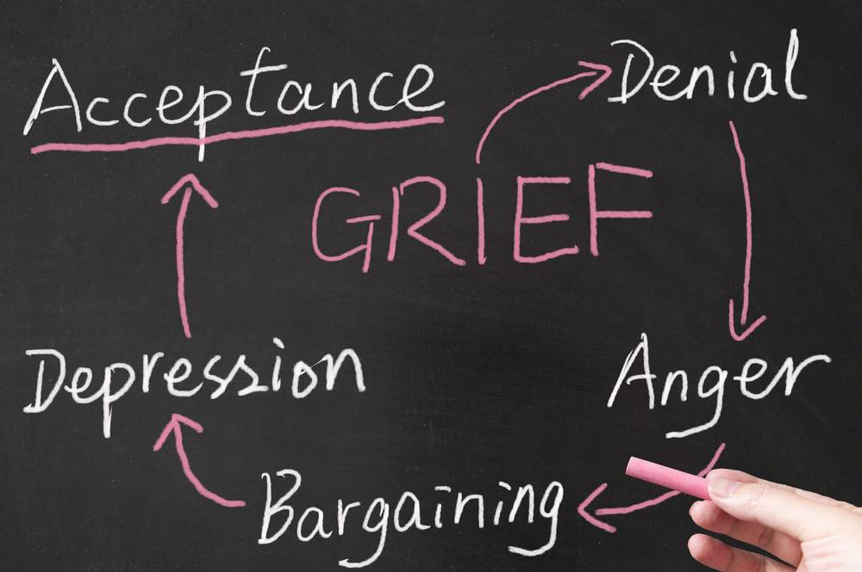

Slide 17
End-of-life counseling may use a variety of therapeutic approaches, but it frequently involves the work of Elizabeth Kubler-Ross, who identified the stages of grief a person is likely to progress through at the end of life.
In the initial stage, denial, people may find it hard to believe the illness is terminal or that it really is happening to them.
In the next stage, anger, people may express feelings of anger and resentment, or a belief that the situation is unfair.
Bargaining, the next stage, may involve attempted deals, generally with the higher power the individual believes in, to prolong life.
The fourth stage, depression, involves feelings of sadness, loss, hopelessness, and grief.
Acceptance, the final stage, involves coming to terms with impending death and feeling ready for it, though not necessarily happy about it.

Slide 18
Care giving
In most cases, the caregiver works along with physicians and follows professional instructions. Caregivers may call the physician or a nurse if the individual:
Experiences excessive pain.
Is in distress or having difficulty breathing.
Has difficulty passing urine or is constipated.
Has fallen and appears hurt.
Is depressed and wants to harm themselves.
Refuses to take prescribed medications, raising ethical concerns best addressed by a person with more extensive formal training.
Or if the caregiver does not know how to handle the situation.

Slide 19
Palliative care
Palliative care focuses on addressing patients' needs after disease diagnosis. While palliative care is not disease treatment, it addresses patients' physical needs, such as pain management, offers emotional support, caring for the patient psychologically and spiritually, and helps patients build support systems that can help them get through difficult times.
Hospice care
While hospitals focus on treating the disease, hospices focus on improving patient quality-of-life until death. A common misconception is that hospice care hastens death because patients "give up" fighting the disease. However, patients in hospice care often live the same length of time as patients in the hospital.

Slide 20
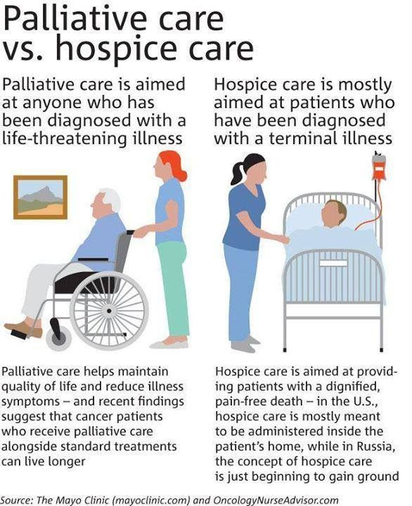

Slide 21
Medications for terminal patients
Terminal patients experiencing pain, especially cancer-related pain, are often prescribed opioids to relieve suffering. The specific medication prescribed, however, will differ depending on severity of pain and disease status.

Slide 22

Physical needs
Pain management is one of the most important concerns of hospice care. In addition to pain medication, the use of traditional psychological interventions such as biofeedback, hypnosis, relaxation and imagery techniques are used to provide skills that increase the client’s awareness and control of pain.

Slide 23


Slide 24
Emotional needs
Dying individuals cope with intense emotions such as anger, fear, guilt, and grief. Dying individuals benefit from counseling as much as anyone and these emotions are both a normal part of the process of dying and can be alleviated by sensitive intervention.

Slide 25


Slide 26
Social needs
The dying individual needs social involvement as much as he or she did before the illness Interventions by a counselor can facilitate the ability of friends and family to enable the dying individual to maintain a social life in the face of physical limitations.
Counselors working with dying children need to be aware of the unique social needs of children to provide developmentally appropriate care.
Play therapy,
Art therapy,
Peer support
Support groups

Slide 27

Too many of us are not living our dreams because we are living our fears.

Slide 28
Death with dignity
One option for end-of-life care is referred to as death with dignity. Death with dignity describes the process in which a terminally ill adult, who is of sound mind and has met certain medical requirements, is given a prescription medication they can take to end their life and die where and when they want to, rather than remain in severe pain and/or unable to function or after quality of life has severely diminished. Many individuals who select this option do so because they want to feel a greater sense of control at the end of their lives and do not want to experience great pain or diminished capabilities.

Slide 29


Slide 30
Effective Counseling
Avoid making recommendations
Do not jump to conclusions
Do not shift from one subject to another
Open ended and closed ended questions
Keep your goals clearly in mind
Determine the patient’s ability
Maintain objectivity

Slide 31


Slide 32

Working with dying individuals can be challenging and very rewarding for counselors. Many counselors report feeling greater love of life, greater appreciation of friends and family, and a more spiritual life from this rich experience of working with people during the last dance of life.

Slide 33


Slide 34
THANKS

